Slide 1
“Analysis and Prediction of Chronic Kidney Disease using Machine Learning Classification approaches” Mentor-Ms. Meena Siwach
Kevin Singh Bagga(01015003117)
Manvendra Gupta(01315003117)
Shivam Kakkar(02115003117)
Shubham Kukreti(02415003117)

Slide 2
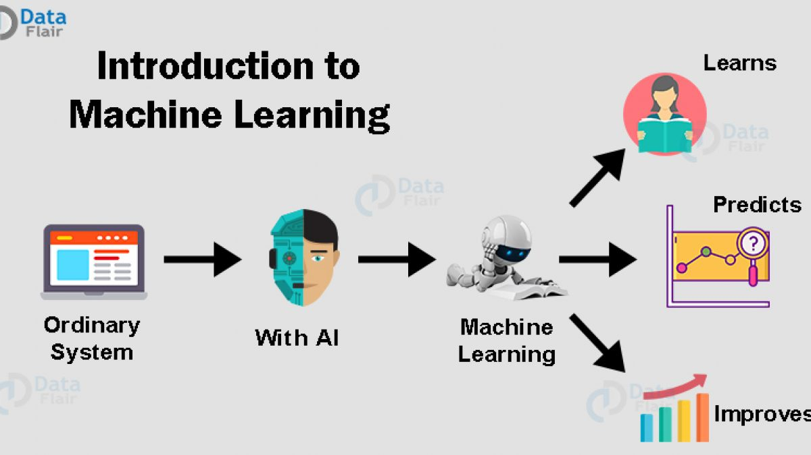
Objective
“Analysis and Prediction of Chronic Kidney Disease using Machine Learning Classification approaches” in order to figure out the best model.

Slide 3
Abstract
Chronic Kidney Disease (CKD) is one of the deadliest diseases that slowly damages human kidney. The disease remains undetected in its early stage and the patients can only realize the severity of the disease when it gets advanced. Hence, detecting such disease at earlier stage is a key challenge now. Machine Learning is one of the emerging field used in the health sectors for the diagnosis of different diseases.
In this project we propose to train the various Machine Learning models using Python and various machine learning libraries like SciKit-Learn, Tensorflow, Keras. Then we will compute, analyze and compare between Machine Learning classification approaches to determine which classification approach is optimal for the prediction of CKD.

Slide 4
WORK PLAN
S. No. | Phases
1. | Data Pre-processing✅
2. | Data Visualization✅
3. | Determining Optimal Algorithms✅
4. | Applying Suitable Algorithm✅
5. | Comparing Results✅

Slide 5
Tests Required to check Kidney Disease
Kidney Function Test
Urine routine and Microscopic Examination
Blood Test
Blood Pressure
Blood Sugar Test
Blood Electrolytes
Complete Blood Count
Blood for Packed Cell
Urine Albumin

Slide 6
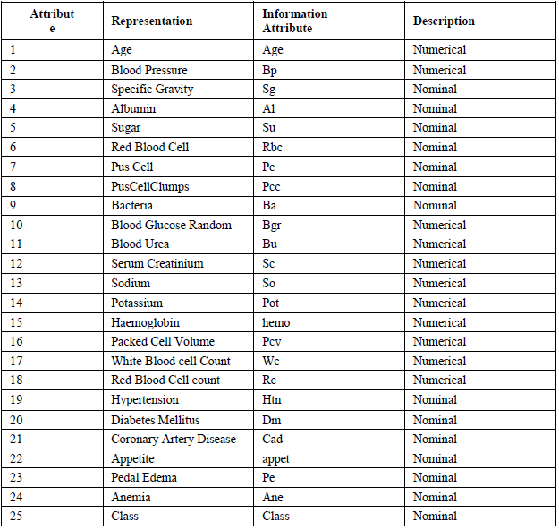
DATASET
Attribute

Slide 7
Data Preprocessing and steps Involved
Cleaning of data for garbage values.
Using techniques like mean and mode to fill the missing values.
Filled the missing values of numeric dataset with the mean of the column.
Filled the missing values of string dataset with the mode of the column.
Further cleaning of data frame if any more NAN values are left.

Slide 8
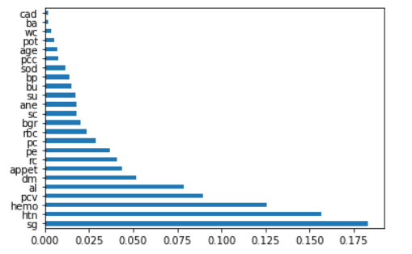
Predictive Accuracy of Attributes From Lowest to Highest
Attributes with highest predictability include-
Specific Gravity
Hypertension
Haemodialysis
Packed cell Value
Albumin
Diabetes Meletus

Slide 9
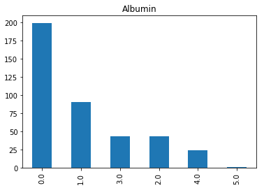
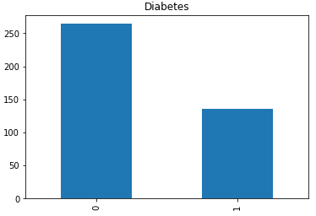
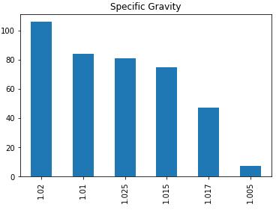
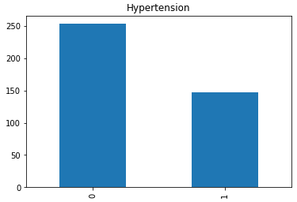
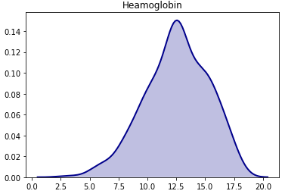
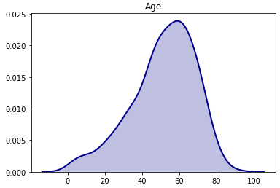
Graphical Depiction of Attributes Selected

Slide 10
Libraries Identified
Pandas
Numpy
Matplotlib
Sci-kit learn
Seaborn

Slide 11
Algorithms Identified
K-Nearest Neighbours
Decision Tree Classification
Random Forest Classification
Ada Boost Classifier
Gaussian NB

Slide 12
K-Nearest Neighbours
K-NN algorithm stores all the available data and classifies a new data point based on the similarity. This means when new data appears then it can be easily classified into a well suite category by using K- NN algorithm.
KNN algorithm at the training phase just stores the dataset and when it gets new data, then it classifies that data into a category that is much similar to the new data.

Slide 13
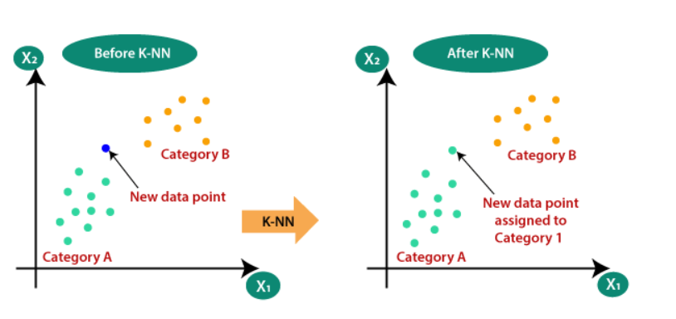
How KNN Works

Slide 14
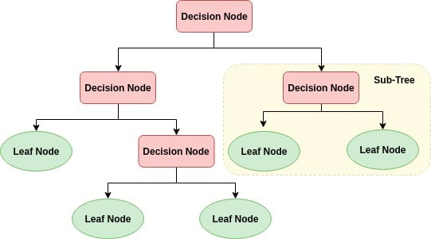
Decision Tree Classification
Decision tree builds classification in the form of a tree structure. It breaks down a dataset into smaller and smaller subsets while at the same time an associated decision tree is incrementally developed. The final result is a tree with decision nodes and leaf nodes.
It Tree consists of :
1. Nodes : Test for the value of a certain attribute.
2. Edges/ Branch : Correspond to the outcome of
a test and connect to the next node or leaf.
3. Leaf nodes : Terminal nodes that predict the
outcome(represent class labels or class distribution).

Slide 15
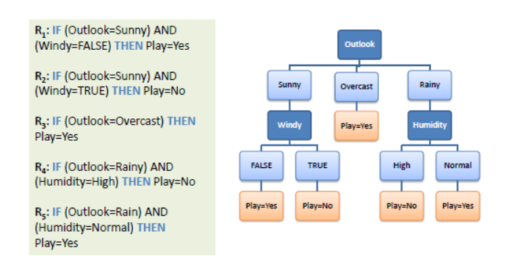
Decision Tree Example

Slide 16
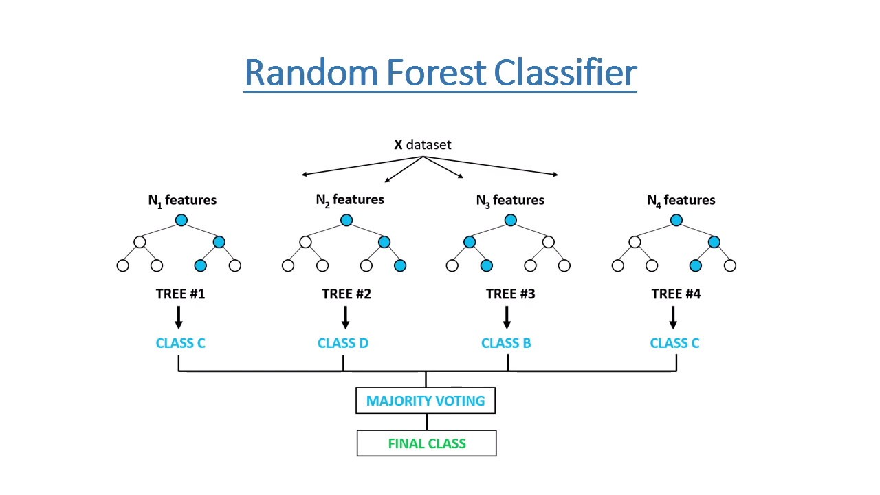
Random Forest Classification
Random Forest Classifier follows the concept of
Ensemble learning.
Ensemble Learning is a process by which multiple
machine learning models such as classifiers, are
strategically generated and combined to solve a
particular machine learning problem.
Random forest consists of a large number of
individual decision trees that operate as an
ensemble. Each individual tree in the random
forest spits out a class prediction and the class
with the most votes becomes our model’s prediction.

Slide 17
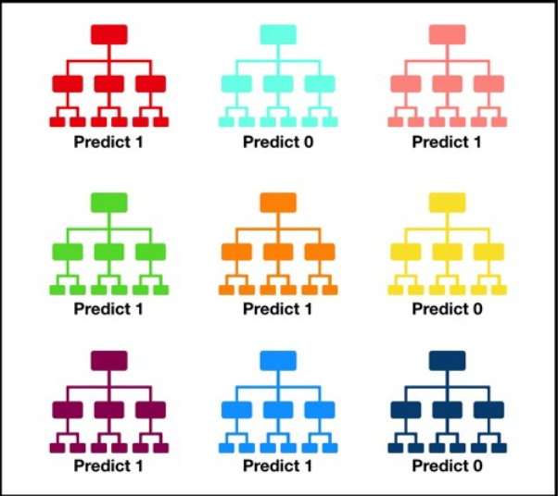
Random Forest Example

Slide 18
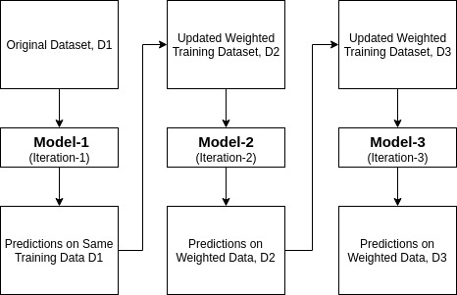
Ada Boost Classifier
Ada Boost Classifier is also a kind of Classifier which
uses boosting technique which is a kind of sequence
ensemble method.
Boosting is a technique that attempts to create a
strong classifier from a number of weak classifiers.
This is done by building a model from the training
data, then creating a second model that attempts to
correct the errors from the first model. Models are
added until the training set is predicted perfectly or a
maximum number of models are added.

Slide 19
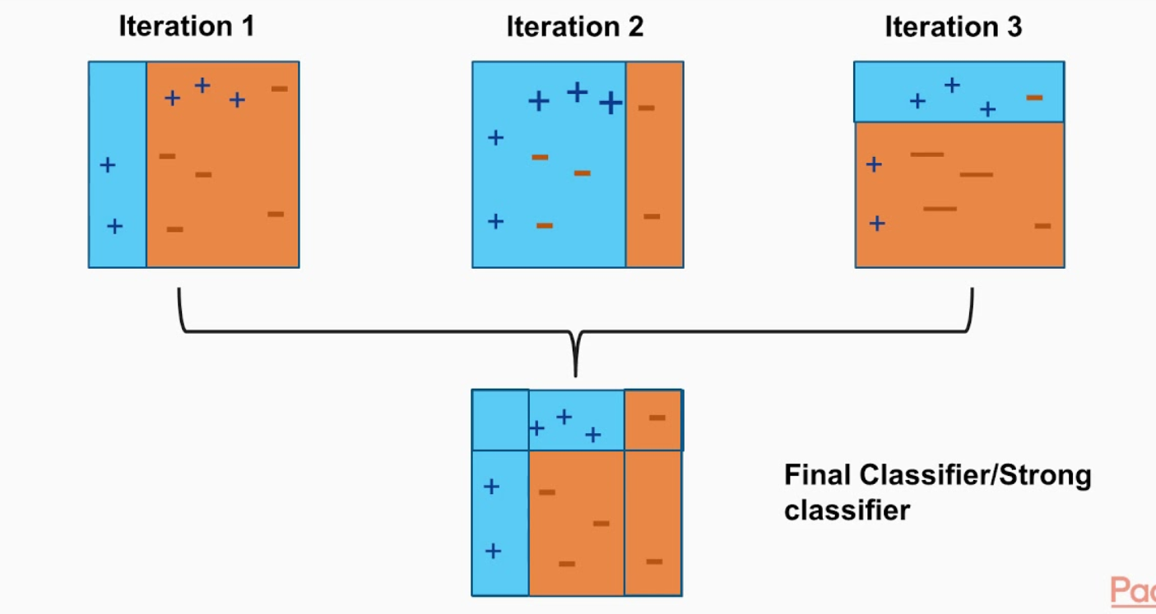
Boosting Process

Slide 20
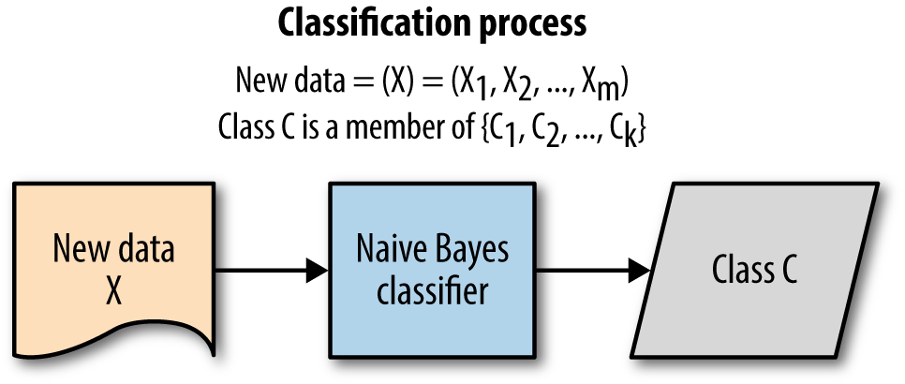
Gaussian NB Classifier
Gaussian Naive Bayes is a statistical classification
technique based on Bayes Theorem of Probability.
It is one of the oldest and simplest supervised
learning algorithms.
Naive Bayes classifier is fast, accurate and reliable
algorithm with high accuracy and speed
on large datasets.
It assumes that the effect of a particular feature in
a class is independent of other features.

Slide 21
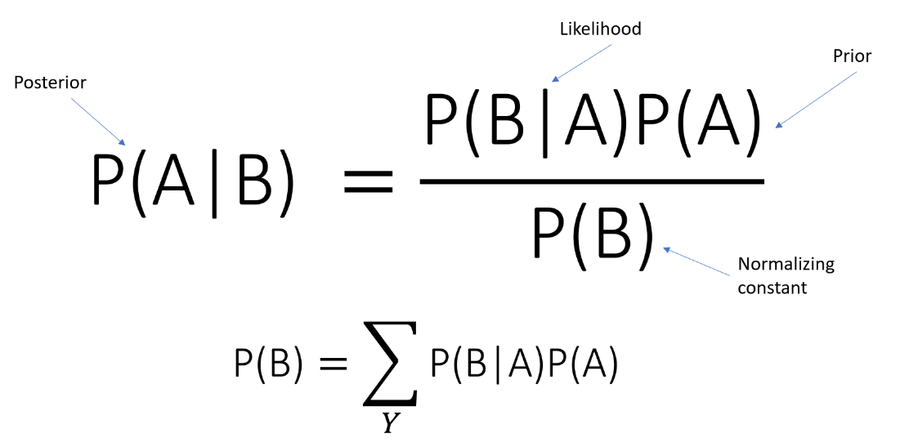
How Gaussian NB works ?
Calculate the prior probability for given class labels
Find Likelihood probability with each attribute for each class
Put these value in Bayes Formula and calculate
posterior probability.
See which class has a higher probability, given the
input belongs to the higher probability class.

Slide 22
Performance Metrics used For Comparison Of Results
Accuracy: Accuracy is the simple ratio between the number of correctly classified points to the total number of points.
Precision: Precision is the fraction of the correctly classified instances from the total classified instances.
F1 Score: F1 score is the harmonic mean of precision and recall.
Log Loss: Logarithmic loss (or log loss) measures the performance of a classification model where the prediction is a probability value between 0 and 1. Log loss increases as the predicted probability diverge from the actual label.

Slide 23
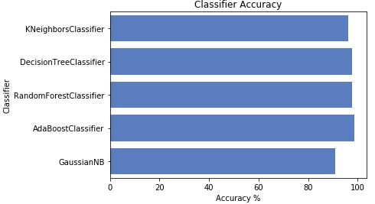
Accuracy Comparison

Slide 24
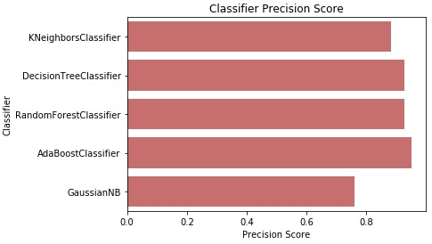
Precision Comparison

Slide 25
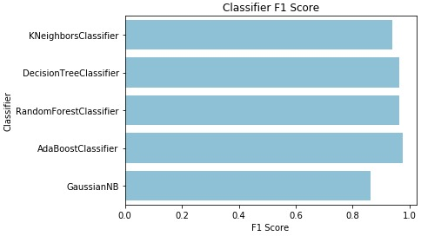
F1 Score Comparison

Slide 26
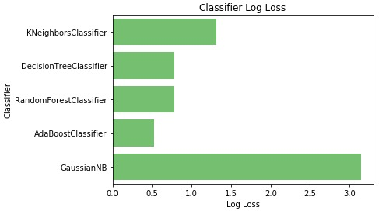
Log Loss Comparison

Slide 27
Conclusion
Ada Boost Classifier Is best classifier based on all the performance metrics – which had an Accuracy of almost 98.5%, a Precision Score of 0.95, a F1 Score of 0.97, and Log Loss value of just 0.52%.
While Random Forest and Decision Tree were 2nd and 3rd respectively but the difference in their performance was negligible.
K-nearest neighbor came in 4th.
At the same time Gaussian NB was the worst performing classifier in all the aspects by a significant margin.

Slide 28
References
W. H. S. D. Gunarathne, K. D. M. Perera and K. A. D. C. P. Kahandawaarachchi, "Performance Evaluation on Machine Learning Classification Techniques for Disease Classification and Forecasting through Data Analytics for Chronic Kidney Disease (CKD)," 2017 IEEE 17th International Conference on Bioinformatics and Bioengineering (BIBE), 2017, pp. 291-296, doi: 10.1109/BIBE.2017.00-39.
R. Ani, G. Sasi, U. R. Sankar and O. S. Deepa, "Decision support system for diagnosis and prediction of chronic renal failure using random subspace classification," 2016 International Conference on Advances in Computing, Communications and Informatics (ICACCI), 2016, pp. 1287-1292, doi: 10.1109/ICACCI.2016.7732224.
A. J. Aljaaf et al., "Early Prediction of Chronic Kidney Disease Using Machine Learning Supported by Predictive Analytics," 2018 IEEE Congress on Evolutionary Computation (CEC), 2018, pp. 1-9, doi: 10.1109/CEC.2018.8477876.

Slide 29


